Slide 1


KONARK INSTITUTE OF
SCIENCE AND TECHNOLOGY
DOCUMENT SERVER
PROJECT BY
PROJECT GUIDE
Guide:- Dr. L.N Padhy
Co-guide:- Mr. Subhashis Mishra
Akshay Kumar (1801214006)
Khushi (1801214032)
Neha Bhagat (1801214050)
Niranjan Singh (1801214054)
Submitted for the partial fulfillment
Of
Bachelor of Technology
In
Computer Science Engineering

Slide 2
CONTENT
Objective
Project Planning
Developed Module
Future Planning

Slide 3
OBJECTIVE
The basic objective of document server is for storing the data and also to achieve security and backup services. This will solve the issue of document losses due to various reason such as System crash, Virus etc.
Users will be provided with a USERID and Password. They have to login into it and should be capable of storing data by uploading it into the server. The formats allowed are to be allowed by the admin as per user.

Slide 4
TOOLS AND PLATFORM USED
Front end
UI Technologies:- HTML, CSS
Language:- PHP 8
Framework:-Laravel 8
Back end
Database:- PostgreSQL 14

Slide 5
Project Planning
Our project Document Server has two modules:-
Admin
MODULES | STATUS
Register | Completed
Login | Completed
Home Page | Completed
Logout | Completed
View users Activity | Working
Shared | Working
Starred | Working
Accessible Rights | Working
MODULES | STATUS
Admin Security | Not Completed
Media Management | Not Completed
File Management | Not Completed
Upload Files | Not Completed
View Files | Not Completed
Download Files | Not Completed
Share Files | Not Completed
Delete Files | Not Completed

Slide 6
User
The user has certain activities such as:-
MODULES | STATUS
Register | Completed
Login | Completed
Home Page | Completed
Logout | Completed
Shared | Working
Starred | Working
User Security | Working
MODULES | STATUS
Upload Files | Not Completed
View Files | Not Completed
Download Files | Not Completed
Share Files | Not Completed
Delete Files | Not Completed
User file Management | Not Completed

Slide 7
Developed Module
The Modules that is developed are:-
Front page
2. Admin
Register
Login
Homepage
Logout
3. User
Register
Login
Homepage
Logout

Slide 8
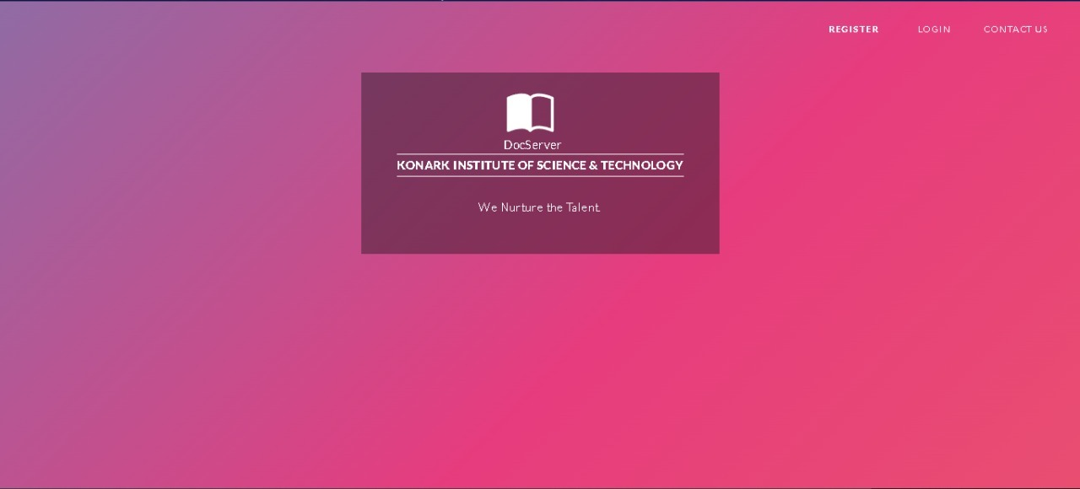
Front Page

Slide 9
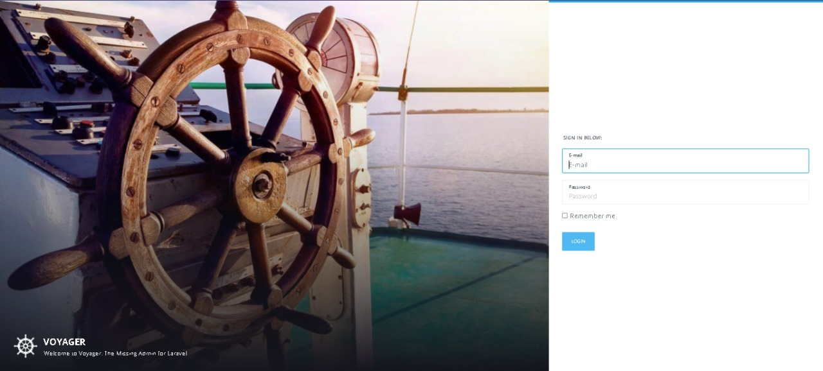
Developed Module of Admin
Admin will be registering from command prompt
Admin login page

Slide 10
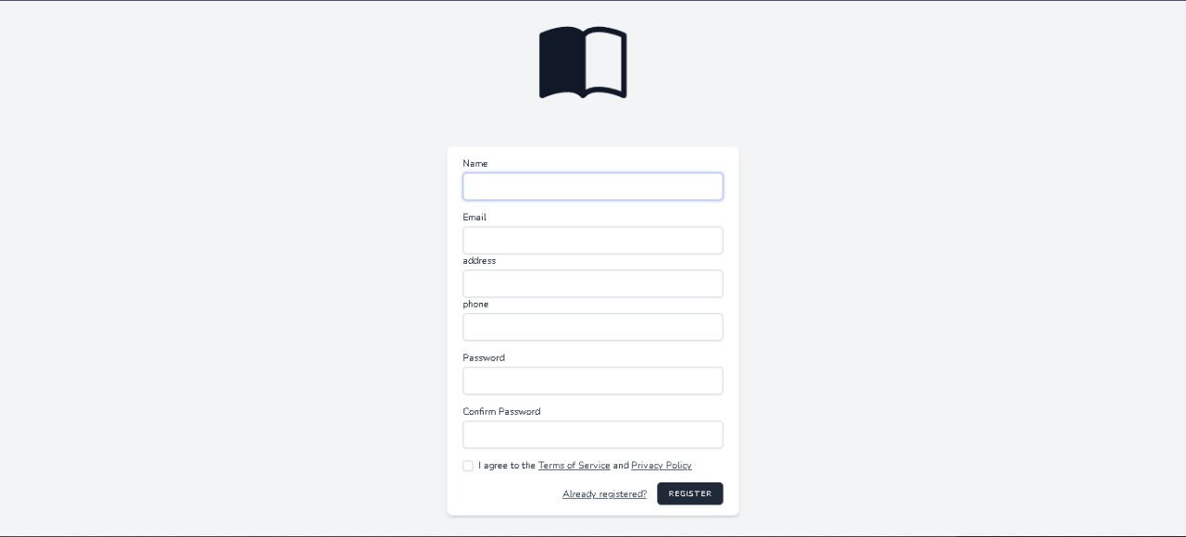
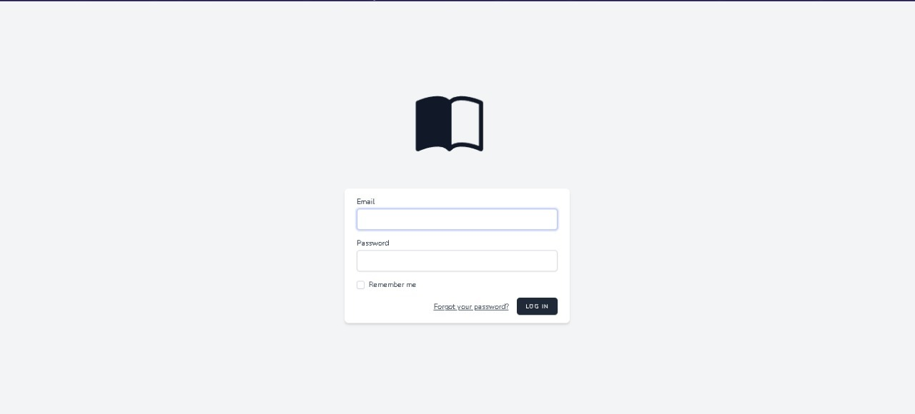
Developed module of user
User registration page
User login page

Slide 11
FUTURE PLANNING
The Modules to be developed are:-
1. Admin
Admin Dashboard
Starred
Shared
Accessibility rights
Media Management
File Management
2. User
Home Page
Starred
Shared
File Management

Slide 12


